Slide 1
POLS 208: Week 9
Quang Bui

Slide 2
Agenda
Going over Bui - “The Impact of the ACA Medicaid Expansion on Diabetes Diagnoses”
Learn more about quasi and natural experiments
Think about how to structure and present paper

Slide 3
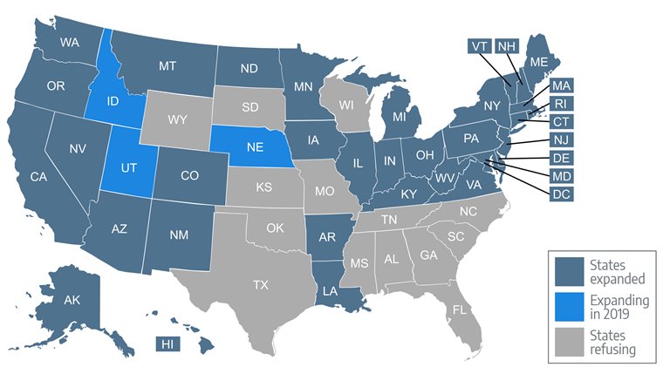

Slide 4
Intro p. 2-3
What type of study is this?
What does the author do to signify the type of experiment used?
What type of variation does the author exploit?
Notes:
Give students 10 minutes to read, discuss for about 15. 25 min
Activity give students 10-15 minutes to discuss. 40 min
Talk about in general what works and what doesn’t for 10 minutes. 50 min

Slide 5
Lit Review/Theory p. 3-5
What is the author’s argument?
How does the author use the lit review to establish the design?
What could be improved about this section?

Slide 6
Data and Methodology p. 5-7
How does the researcher collect their data?
Why was the data was chosen?
Why does the author select this research design?
What is the hypothesis? Does it test the theory?

Slide 7
Results p. 8-11
How does the author relate their findings to the theory?
How does the author try and signify the importance of the findings?

Slide 8
Takeaways
What could you differently from this paper?
How could the research design have been improved?
What are some important considerations for natural and quasi experiments that you noticed from this paper?
Although your paper does not have a data analysis component, was there anything useful about how to structure your research design and paper?

Slide 9
For Next Week:
Weekly assessment
Work on draft

Slide 10
Email: quang.bui@emory.edu
Office Hours: M 2-3
Tarbutton 116

